Slide 1



ANTHONY LORA
THE
Capstone
OF GENESIS
Modern day implementation of creation.
Let’s jump in!

Slide 2


Our goal is to create a game that simulates the effects of gravity, contains collision detection, & user interactive environment with mouse events. This will be hosted on a local server, and use front-end programming to edit files via the web browser.
OUR PROJECT
& FEATURES
GOALS

Slide 3

OUR PROJECTS
ALGORITHMIC DESIGN
STEP 1 - INPUT
STEP 2 - PROCESSING
STEP 3 - VALIDATION
STEP 4 - OUTPUT
STEP 5 - VALIDATION+
STEP 6 - REPETANCE
User will press their mouse, as this will signify input for the program to process
User input will get passed through and processed for directional movement
Will take processed directional movement and compute gravitational simulation accordingly
Displays interactive game
Will check if the player model has interacted with any “no zones”
If player model passes further validation, game will loop and keep generating content

Slide 4


WHAT IS SDLC?
The “Software Development Life Cycle”, is the process used in which to build an engineered system.
For this demonstration we will be using Jira, a Project Management software that allows for collaboration and debugging.

Slide 5

IDEATION
The first step is Ideation, which is the brainstorming of ideas that solve problems the user faces. Our purposes demand an application that simulates gravity, collision, and directional input. Furthermore, we will need a web browser to track statistics, a local server to host this on, and a program that will automatically update information.
STEP ONE

Slide 6
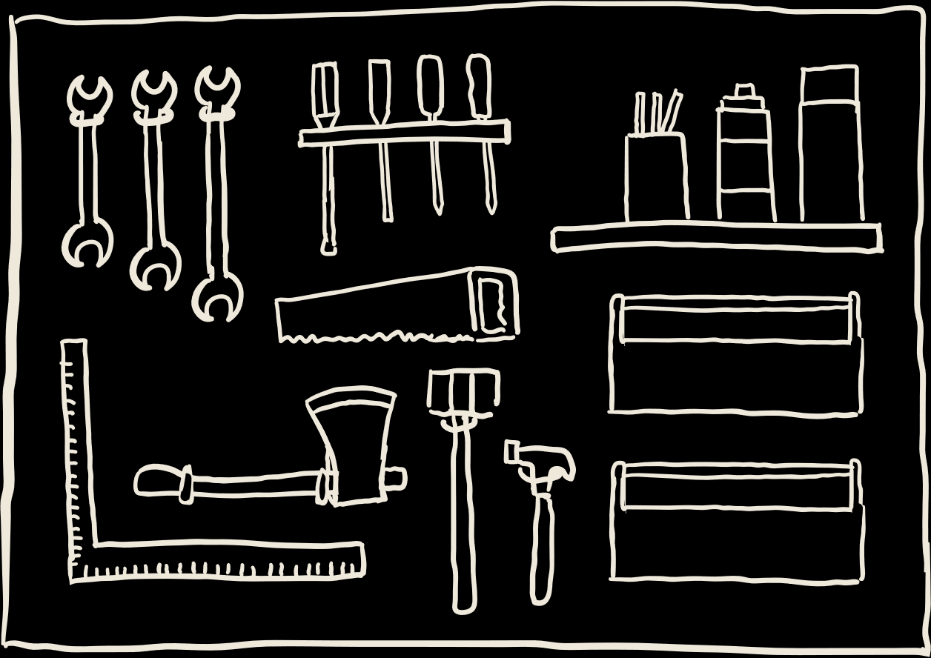
REQUIREMENTS
The second step is the “Requirement Phase”. Here is where you will collect data, contact stakeholders, & see what is needed to complete this project. In this demonstration we will need a Java program that runs the game, Django that will host the server, and JavaScript that will customize accordingly.
STEP TWO

Slide 7

DESIGN
Step 3 is where you start to develop design. In order our design will follow:
Java Program - A model creation that will log every score to a text file, which is then outsourced to our Django Page that will use it as a database.
Django Page - A web browser will use integrated Python packages such as Json, matplotlib, & HttpResponse to format AND display our given data.
JavaScript Functionality - A program that will allow you to clear the data from the website, while automatically updating the backend every 60 seconds.
STEP THREE

Slide 8


Step 4 is the development phase. This is where a programming language is decided, and built upon via the development team. Since it was already decided, This step was used to engineering the basis upon which our final product was built.
DEVELOPMENT
STEP FOUR

Slide 9

TESTING
Step 5 is testing, in which troubleshooting is the main focus of production. Some issues come across were:
Holding and STORING every value after every run of the Java
Gathering a method in which to display the data itself, mixing Python & HTML
Using JavaScript inside of Django as it uses static files, equating to difficulty importing libraries.
STEP FIVE

Slide 10

DEPLOYMENT
Step 6 is deployment, in where we prepared the program to run in a specific environment. To summarize we,
Created a Java Program that exhibits collision detection, gravity simulation, user input, and logs data while running.
Locally hosted a server that contains and displays all of our data; Simultaneously sourcing other programs to run various features.
Designed a web page using HTML, CSS, and JavaScript.
Automatically updated information every 60 seconds for validation through JavaScript.
STEP SIX

Slide 11


THANK YOU.

